Slide 1
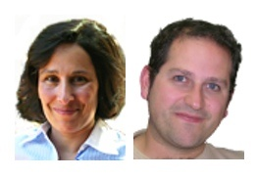
Ontology Engineering Group
Prof. Dr. Asunción Gómez-Pérez
Dr. Oscar Corcho
Escuela Técnica Superior de Ingenierios Informáticos
(antigua Facultad de Informática)
Universidad Politécnica de Madrid
Campus de Montegancedo sn
28660 Boadilla del Monte, Madrid
http://www.oeg-upm.net
{asun,ocorcho}@fi.upm.es
Phone: 34.91.3367439, 34.91.3366605
Fax: 34.91.3524819

Slide 2
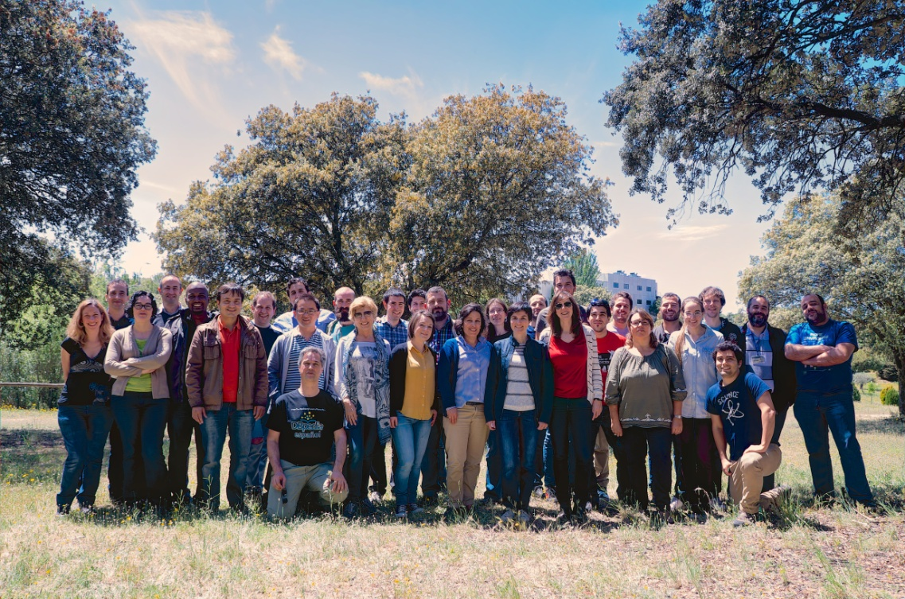

About us
Directors: A. Gómez-Pérez, O. Corcho
Position: 8th in the UPM ranking (200 groups)
Madrid node of the Open Data Institute
Research Group (30 people)
2 Full Professors
5 Associate Professors
3 Assistant Professors
7 Senior Postdocs
6 PhD Students
2 MSc and BSc Students
2 software engineers
1 system administrator
2 project managers
170+ Past Collaborators
50+ Past Visitors
http://www.oeg-upm.net/
https://github.com/oeg-upm
@oeg-upm

Slide 3

Ontology Engineering Group at a glance
Created in1995
World-wide known in the research areas
Ontologies
Semantic Web and Linked Data
Multilingual linked Data
Open Data
eScience
Projects (> 12M€)
27 EU projects (7 as coordinator)
54 National Projects
27 contracts with companies
Awards: SUR IBM Watson
Publications
106 journals
362 International conferences and book chapters
7 Books
Impact of publications H-index
Asunción Gómez-Pérez (h:50, citations 15025)
Oscar Corcho García (h: 36, citations 8258)
Services to the Spanish community
Host esDbpedia
Host linkeddata.es
Awards and Prizes
Ada Byron, Fujitsu, Open data, ISWC
SUR Awards Watson for Tech. Watch
Supervision of students
28 Ph.D thesis (9 awarded best thesis prize)
>150 MS.C thesis and BS.C
Events organization
11 editions of the International Summer School on Ontological Engineering and the Semantic Web
> 50 WS and tutorials
Standardization activities
>25 @ W3C, ISO, ETSI, OASIS, etc.
Mobility
PhD students: 3-6 months abroad
Postdocs: 1 month every 2 years
Visibility
Program chairs of ESWC, ISWC, KCAP, EKAW, TKE, TIA
Editorial board of Journals
Invited talks at conferences and events
Programme Committee presence

Slide 4
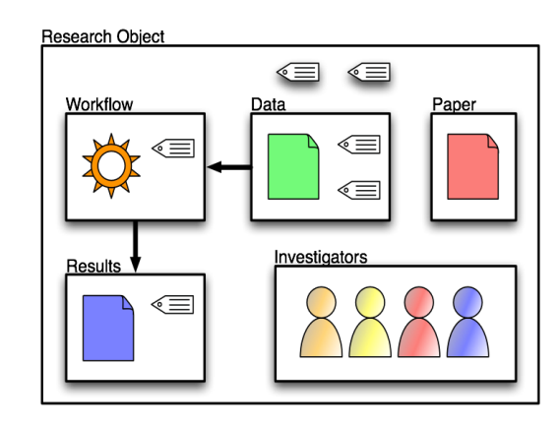


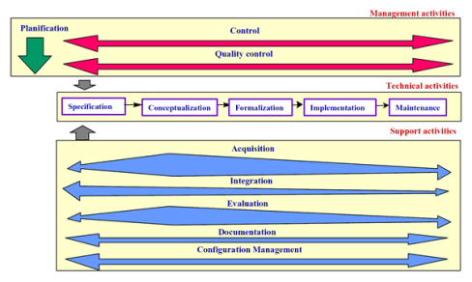
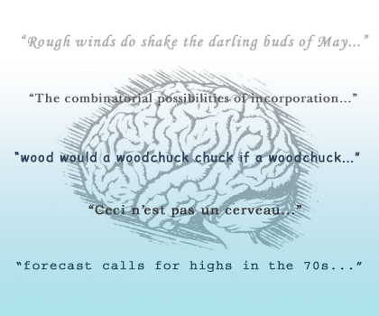

Our Research Areas
Ontological Engineering
Linked Data-based Data Integration
Open Science
(Social) Semantic Web
Data-driven
language technologies
2004
2008
1995
2000
1997
Notes:
http://www.dataimc.com/image/integration1.jpg
http://www.getsticki.com/corporate/Portals/1/images/CustomerAndLaptops.jpg
http://rhizomik.net/~roberto/thesis/figures/MethontologyLifeCycle.png
http://webilus.com/wp-content/uploads/2007/11/folksonomy.thumbnail.jpg
http://ocw.mit.edu/NR/rdonlyres/Global/F/F524CEB7-B7A5-406A-8281-76C5DAAE3AAC/0/chp_brain_language_3.jpg

Slide 5
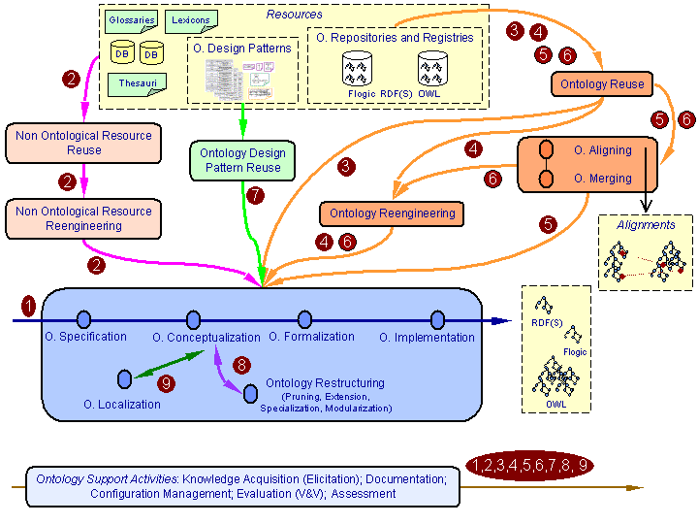
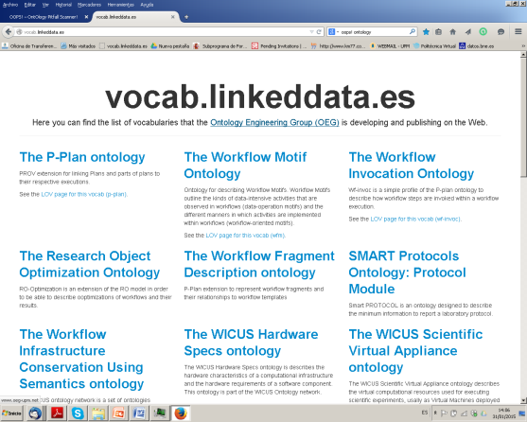
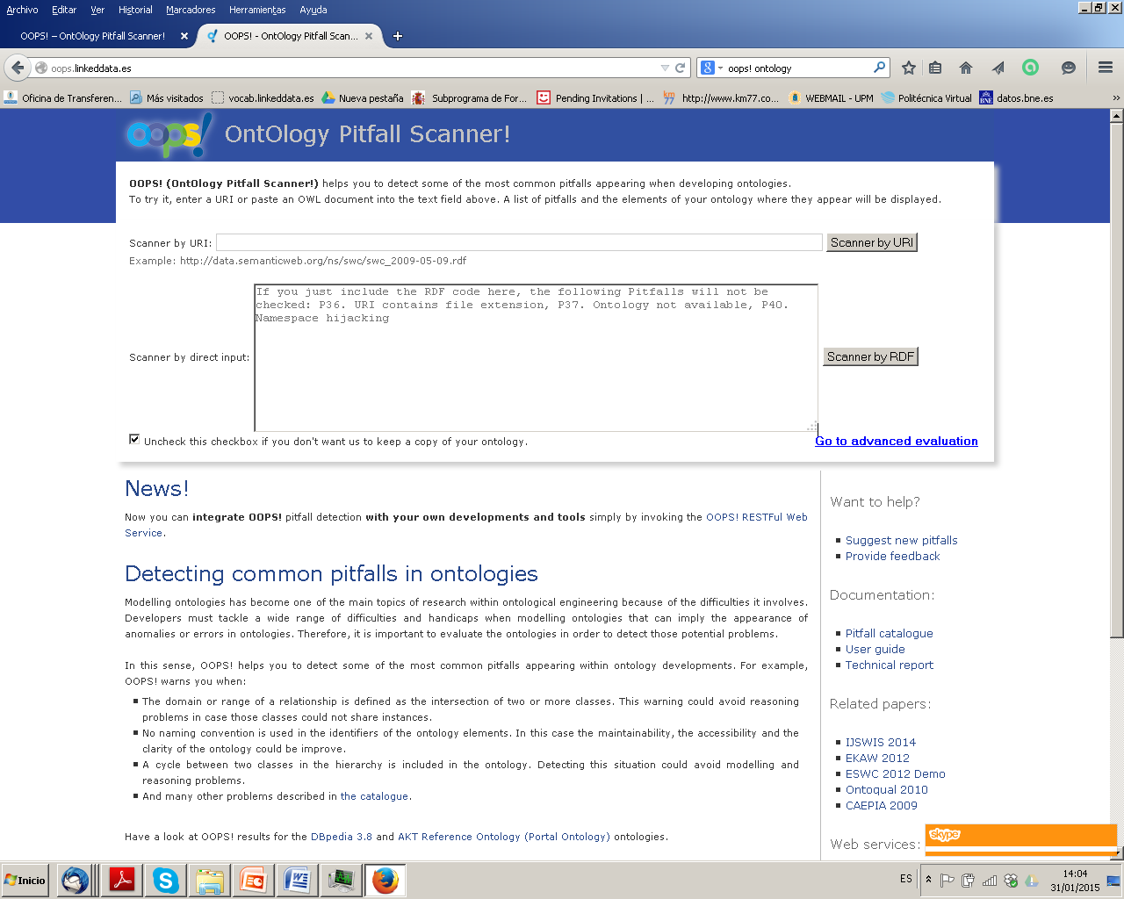

Ontological Engineering
METHONTOLOGY and NeOn methodologies for building Networks of Ontologies
world-wide used
Ontology Evaluation
Oops! (2.000 users, > 50 countries)
Vocabulary publishing
Widoco
Ontologies
Metadata Vocabularies (@W3C)
Provenance (@W3C)
Geography (@IGN, CENIG)
(Multi)-Media (@W3C)
Knowledge Management
Software Engineering (OSLC@OASIS)
Tourism
User experience
Internet of Things (@W3C)
AENOR vocab. for smart cities
Libraries (@BNE)
Health (@WHO)
e-Science
…

Slide 6
Data-driven language technologies, mainly Spanish
Terminology
Corpus management
Lexical database with 3,000 Spanish nouns Meaning-Text Theory )
Terminology generation from RDF sources (esDBpedia, datos.bne.es, etc.)
Alignments of terminologies
Semantic grounding of terminologies
Word Sense Disambiguation
Multilingual and Monolingual
Semantic disambiguation of folksonomies (Sem4Tags)
Annotation and Linking
Multilingual and Monolingual NER
Cross-media (text, images, …)
Linguistic Linked Data
Opinion Mining
Sentiment analysis in Spanish over microblogs and tweets
Time-based analysis of events in tweets.
Text Mining
Text Classification and mining
Text Annotation
SPARQL queries structure analysis
Guided Question Answering on esDBpedia
Query classification
Frequency-based User Questions Patterns
Guided Natural Language Query completion
Information Extraction
Ruled based systems
Relation extraction and scoring
Multilingualism
Linguistic models for ontologies
Ontology localization
Multilingual lexico-syntactic patterns
Generation and publications of Language Resources
Crosslingual linking
In use
Text annotation for the Spanish Agency of Drugs
FAQ enhancement for Banco Santander
Technology Watch for EOI
Time-based analysis of tweets for TimeOut Inc.
Sentiment analysis for Havas

Slide 7


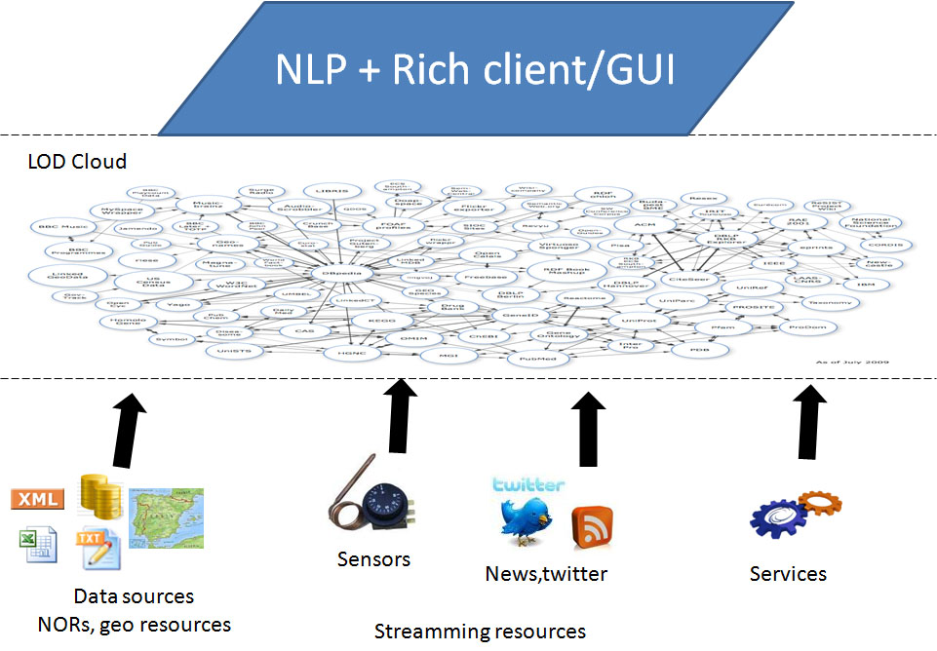



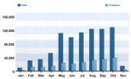
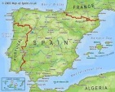
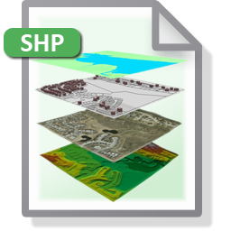


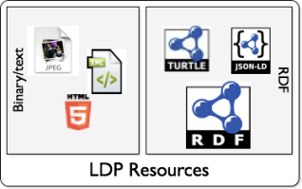
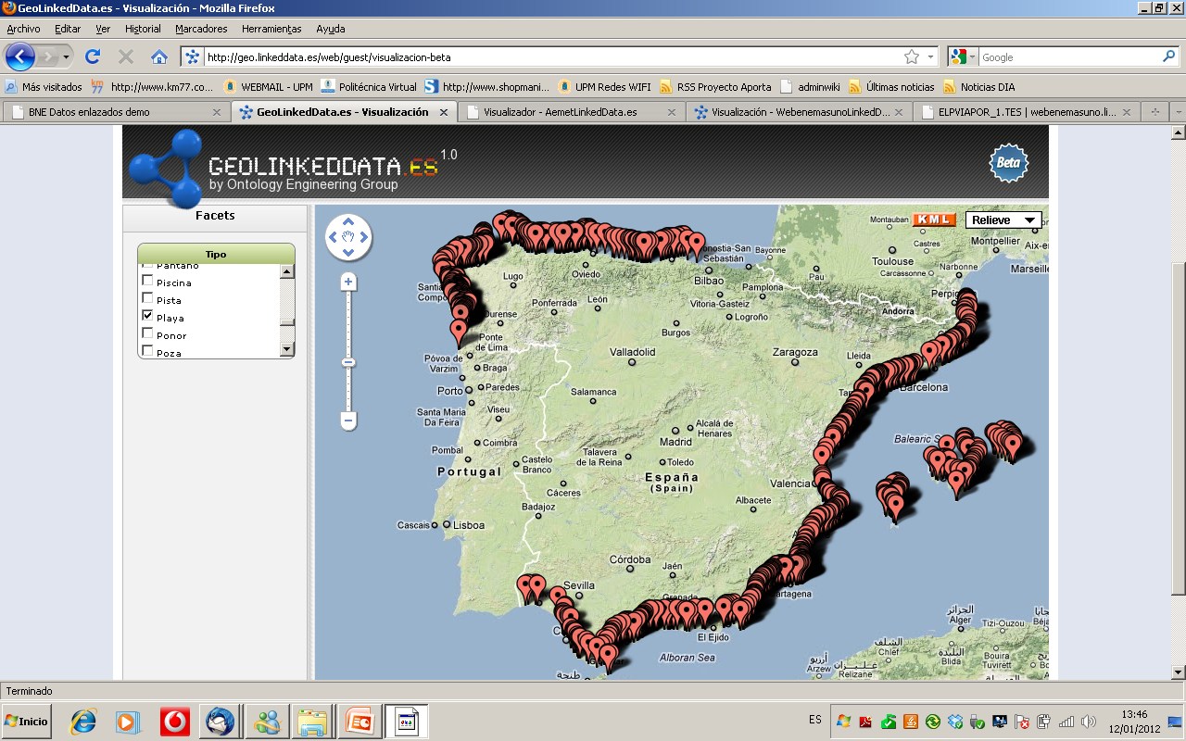
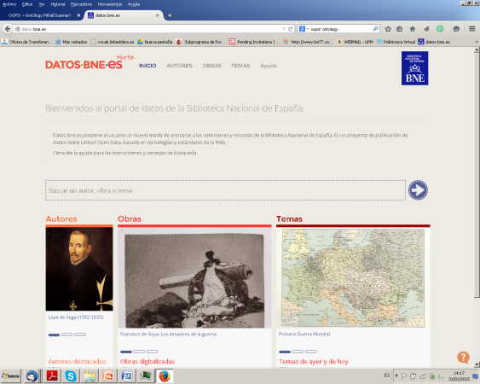
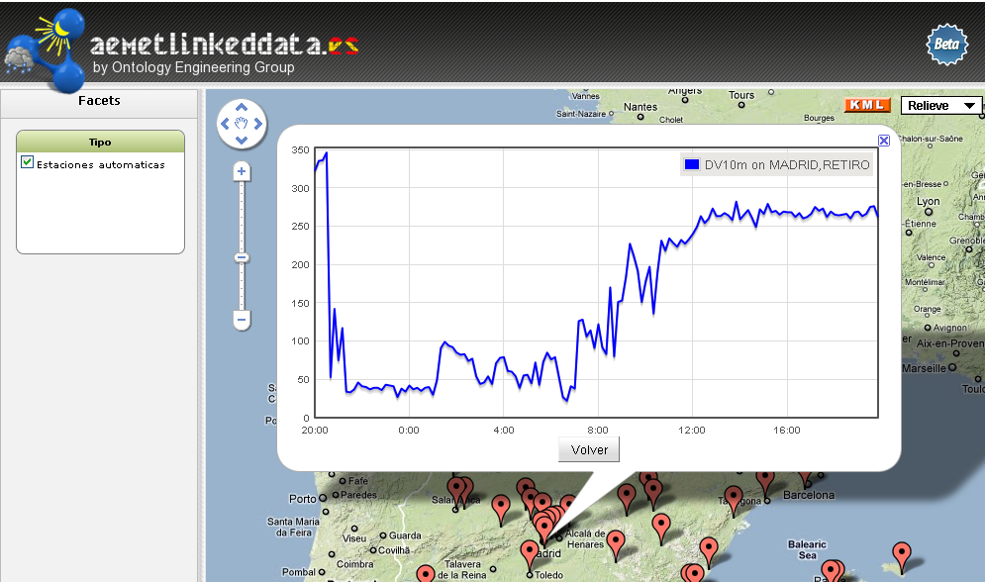
Linked data Technologies and Project @ OEG
Morph
NOR₂O
Geometry2RDF
Marimba
SPARQL
-Stream
Sem4Tags
geo REST service annotation
shp2RDF
LDP4j
RDF Generation and Linking
Visualization
Map4RDF
Linked Library Data Visualisation
Sensor Data Visualisation

Slide 8
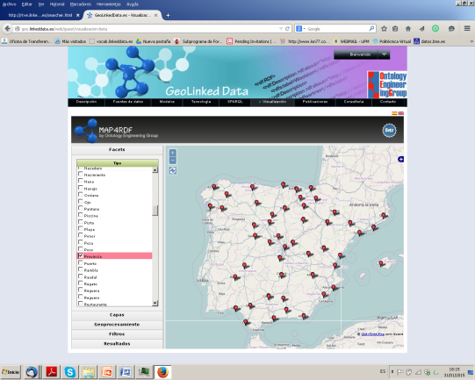
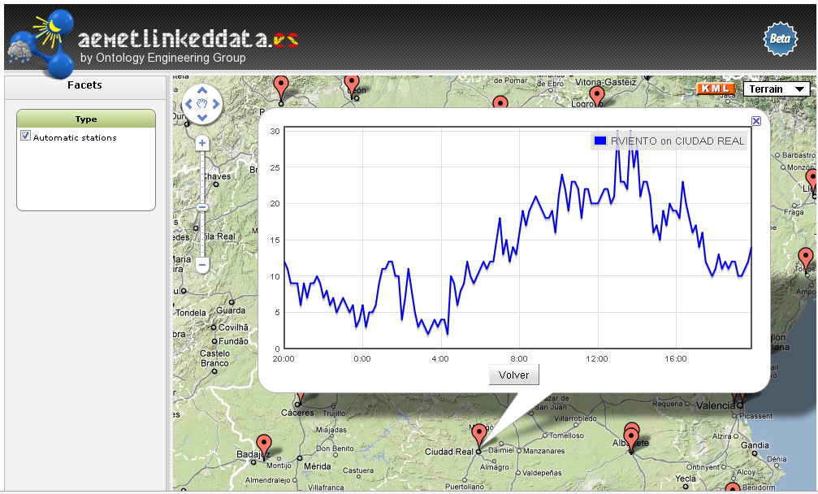
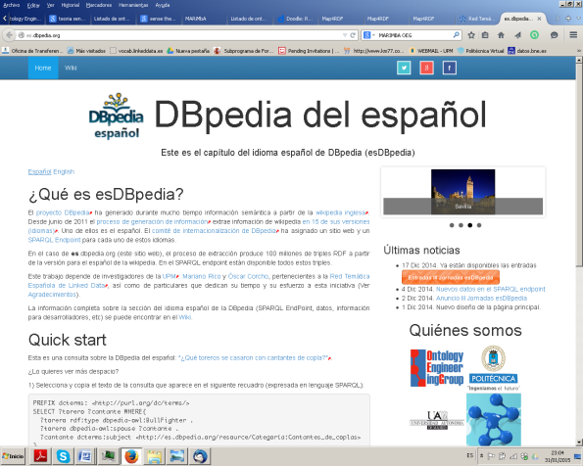
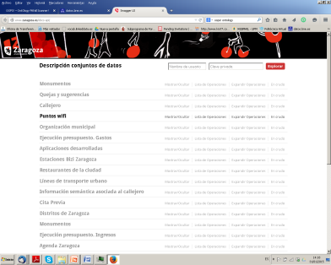
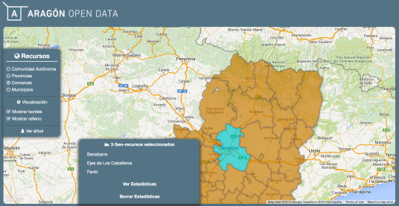
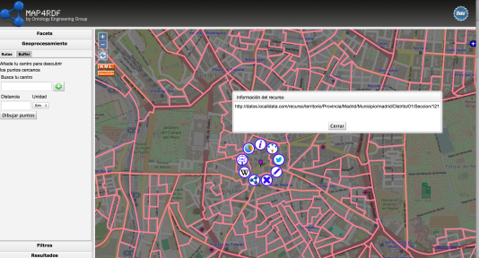
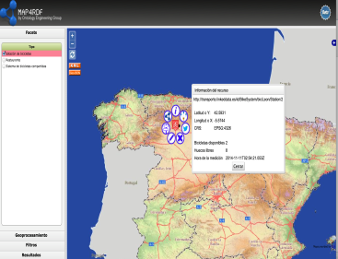
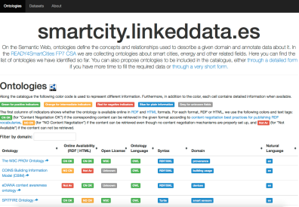
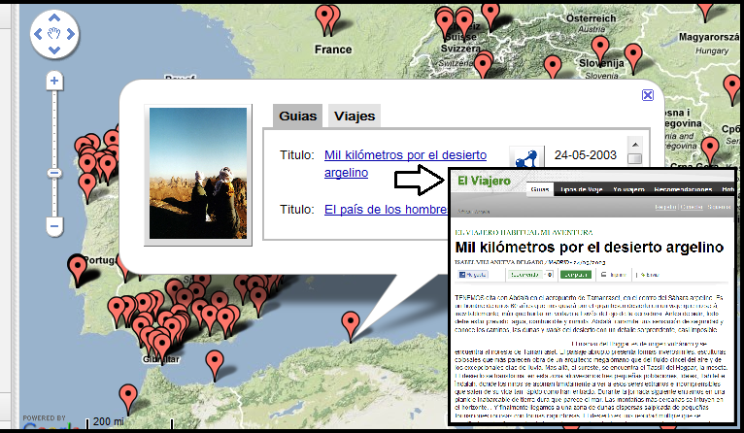
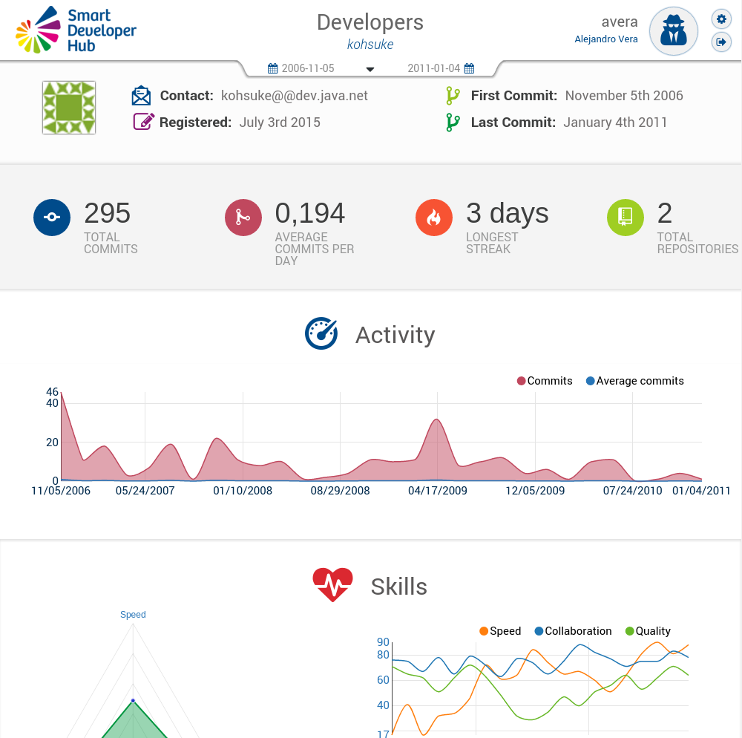
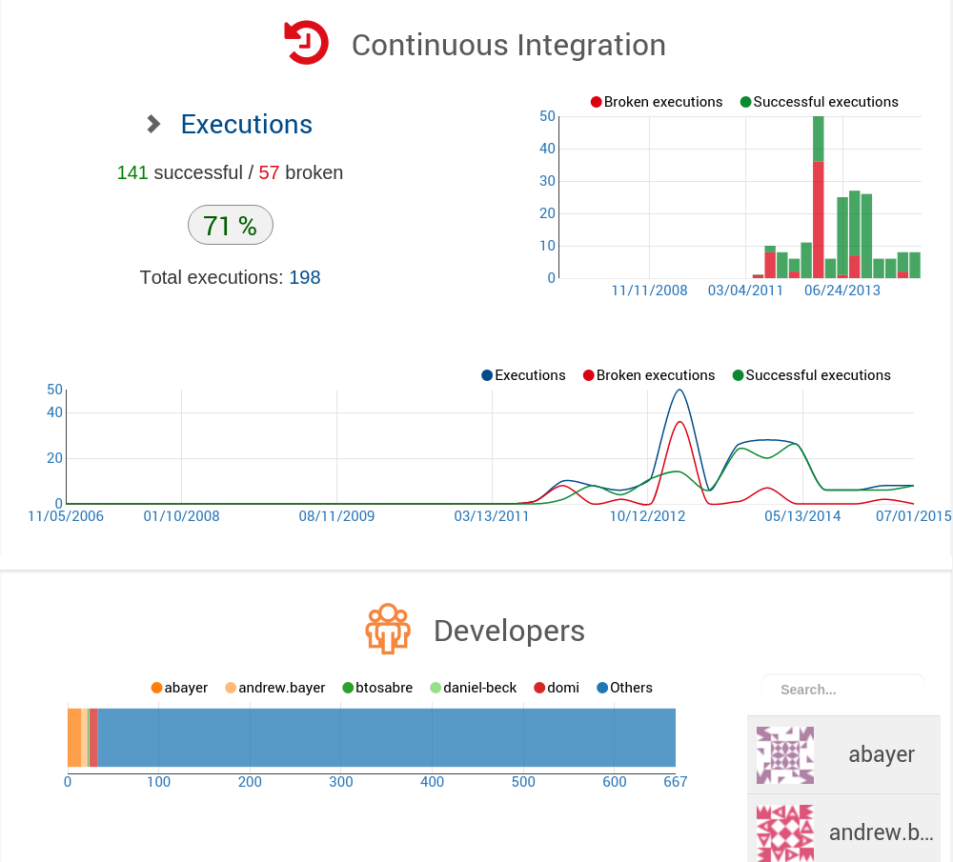
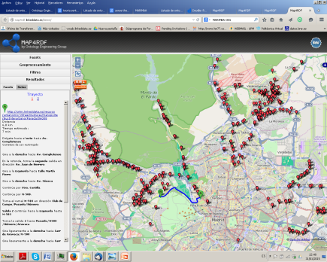
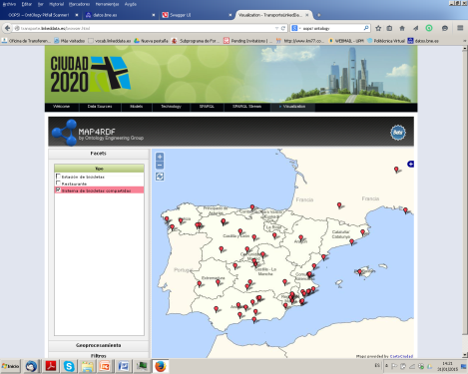
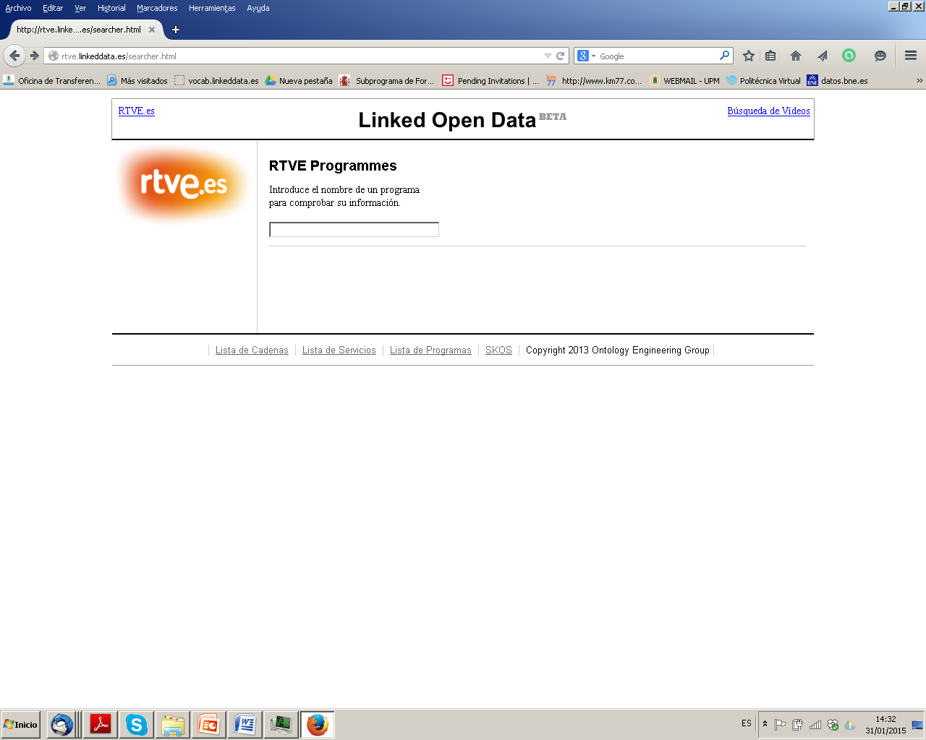
Linked Data applications
Culture (@BNE)
Geographical (@IGN)
Metereological (@AEMET)
Host of esDBpedia
Smart Cities and Open Data (@ Zaragoza, Gob Aragón, Jacathon, Catalogues)
News and Media (@Prisa, RTVE)
Application Lifecycle M. (Banco Santander)
Internet of Things ( @CRTM, Bike sharing system)

Slide 9




OEG projects in the health domain
Development of an ontology for representing the International Classification for Patient Safety (ICPS)
2009
Identification of diseases for which the drug is prescribed in order to obtain more control over the national demand
2014
Identification of adverse reactions to automatize pharmacological surveillance processes over the population
2015
Services for the ellaboration of mathematical models for population segmentation (including health factors)
2016

Slide 10
Ontology Engineering Group
Prof. Dr. Asunción Gómez-Pérez
Dr. Oscar Corcho
Escuela Técnica Superior de Ingenierios Informáticos
(antigua Facultad de Informática)
Universidad Politécnica de Madrid
Campus de Montegancedo sn
28660 Boadilla del Monte, Madrid
http://www.oeg-upm.net
{asun,ocorcho}@fi.upm.es
Phone: 34.91.3367439, 34.91.3366605
Fax: 34.91.3524819

Slide 11
Collaboration with the World Health Organization
ICPS: International Classification for Patient Safety
To transform the ICPS into an ontology network
From ontology specification to implementation
Specific domains:
Falls
Pressure ulcer
Reuse:
Ontological resources
Non-Ontological resources
No public results

Slide 12
ICPS - Domains and resources analysis

Slide 13
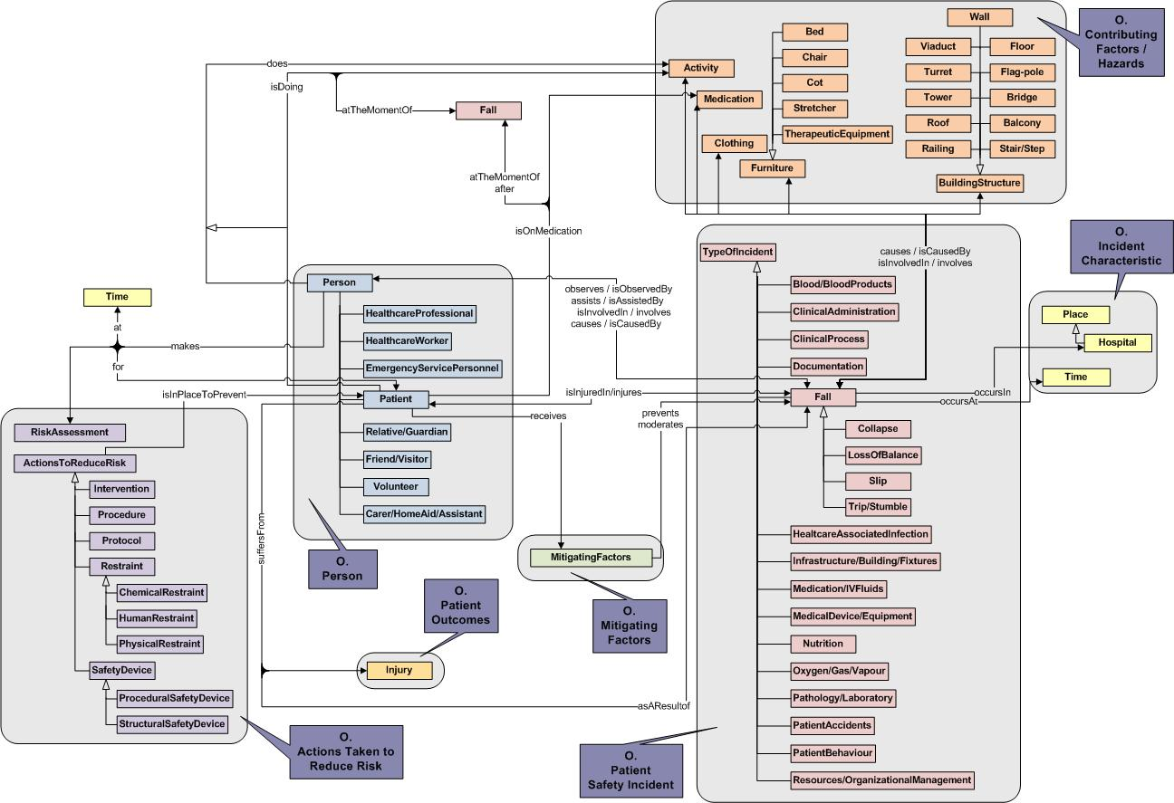
ICPS - High level conceptual model

Slide 14
AEMPS - Input (Projects 1 and 2)
Drug fact sheet
Official document of the drug with the essential information
In Natural Language
No common format
Project 1 focuses on the identification of diseases for which the drug is prescribed
Drug Name
Asenapina
Therapeutical information
For patients with schizophrenia.
Adverse reactions
May produce headaches.
Project 2 focuses on the identification of of adverse reactions
………………………………………………………….
Drug fact sheet of Asenapina

Slide 15



AEMPS - Performed tasks
Natural Language Processing
Mapping
Disease identification based on lexical-syntactic patterns and dictionaries
Patterns are dependent of the semantic value of the disease (Prescribed for or adverse reaction)
Homogeneous term search on terminologies or dictionaries
Unique representation for a disease
Algorithms to provide best candidates without false positives
Drug Name
Asenapina
Therapeutical information
For patients with schizophrenia.
SNOMED-CT
Therapeutical information
For patients with schizophrenia.
Mapping
Systematized Nomenclature of Medicine – Clinical Terms
Adverse reactions
May produce headaches.
Adverse reactions
May produce headaches.
Mapping
MedDRA Dictionary
………………………………………………………….
Drug fact sheet of Asenapina
Medical Dictionary for Regulatory Activities

Slide 16
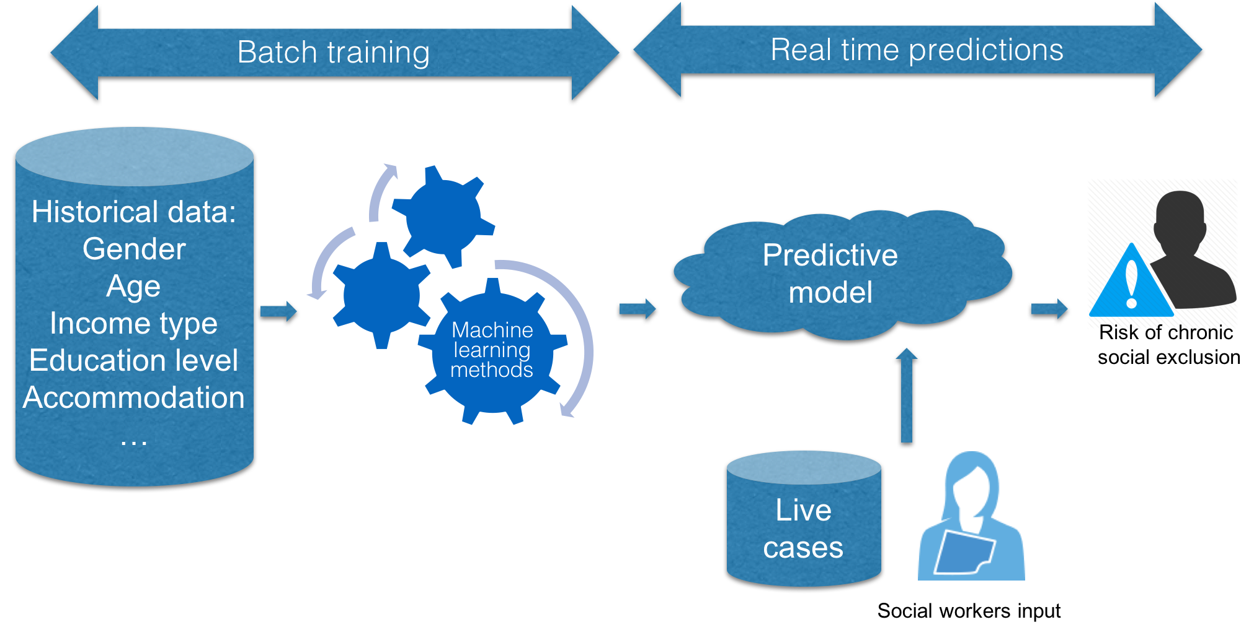
Analyzing and predicting social exclusion
Outcomes:
Predictive model of chronic social exclusion based on machine learning techniques
Segmentation model of the population and study of the main features in the social exclusions groups
Ontology network which covers the aforementioned models while offers a shareable formalization of the social exclusion main concepts

